Slide 1

Graduate Housing Recommender App
ATLS– 5214 Big Data Architecture
The Last Dance Presents
Janani Selvan
Veena Prasad
Akash Iyengar
Akash Shanbhag

Slide 2
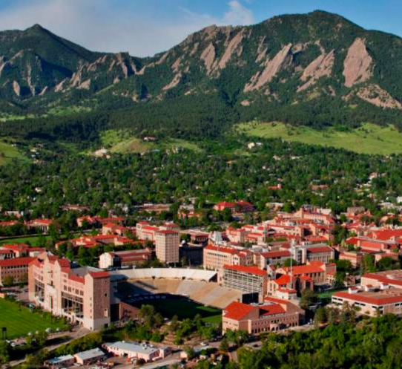
Introduction
Starting college implies moving into new town/city/state/country for students
On-campus housing can’t always be guaranteed
Finding off-campus housing is a struggle (unaware about the place)
Our app is the go-to spot for all college students looking for housing
Our app - Recommendation, proximity, crime score indicator, walk score indicator and much more

Slide 3
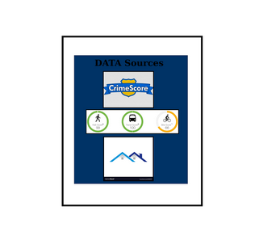
System Architecture

Slide 4
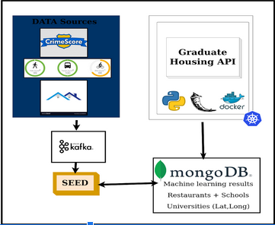
System Architecture

Slide 5
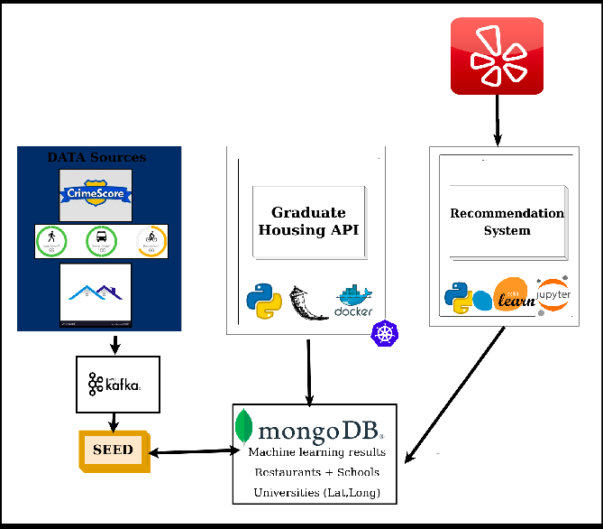
System Architecture

Slide 6
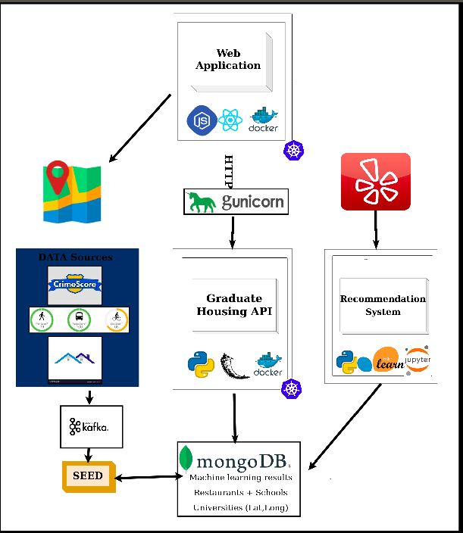
System Architecture

Slide 7
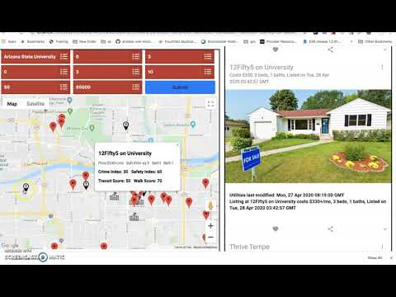
Project Demo

Slide 8










Tech Stack
Software: -
Programming Languages – Python, React.js, HTML, CSS
Web Technologies – Flask, NodeJS
Data Management – MongoDB, Apache Kafka, Elastic search, Logstash, Kibana
Miscellaneous – Jupyter Notebook, Docker, GCP
Project management - GIT, Pivotal, Whatsapp

Slide 9

Challenges
Scraping Data from multiple sources
APIs lacked the required data
Making sense of the data from multiple sources were hard
Connecting the data derived from multiple sources
Frontend was challenging
Remote meetings made communication difficult

Slide 10

Future Scope
Circle CI can be used in the project
Obtain better data so recommendations can be better
Increase the scope of the project to a larger user base

Slide 11

Questions?

Slide 12
Thank you!
The team members of “The Last Dance" are: -
Akash Iyengar
Akash Shanbhag
Janani Selvan
Veena Prasad

